Slide 1
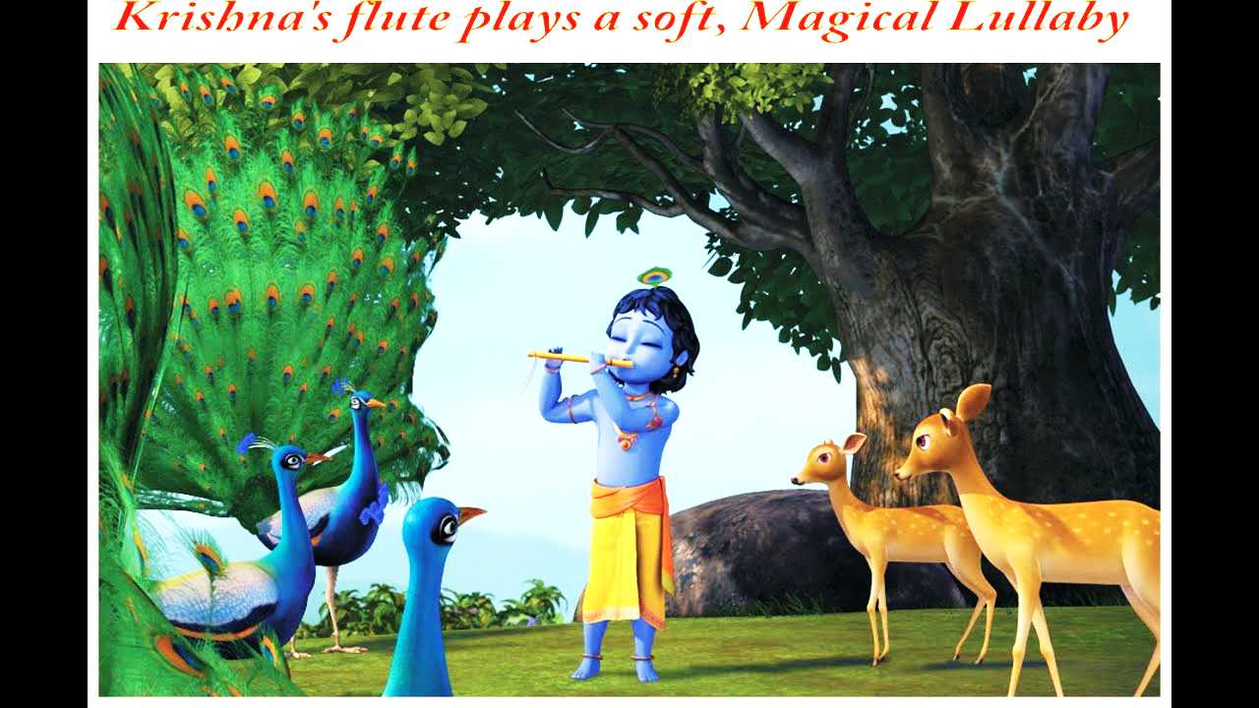







Discover
Sublime joy through sound
SPEAKER
Mr. Manoj Gupta
B.Tech IIT-KGP,
Best B.Tech and M.Tech Project award,
Paper published in Symposium,Orlando,Florida,USA
Secured gold medal in RMO,MATHS Olympiad 2004,2005,2006..
DATE = 17th December , 2023
TIME= 09:30 AM, Sunday

